Slide 1
Vaccine and Bioinformatics

Slide 2
Aim
Immunoinformatics: Computational vaccinology or vaccine informatics is closely related to immunoinformatics.
To predict T-cell immune epitopes and B-cell functional neutralizing
Vaccine:
1- Multi epitopes vaccine, recombinant protein
2- DNA vaccine
3- mRNA, siRNA
4….

Slide 3
Target selection
New concern
Lack of experimental vaccine
Available vaccines are not efficient

Slide 4
Target
Covid 19 spike protein
Exposed protein
Suggested to evoke immunity systems

Slide 5
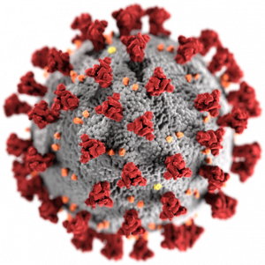
Exposed protein

Slide 6
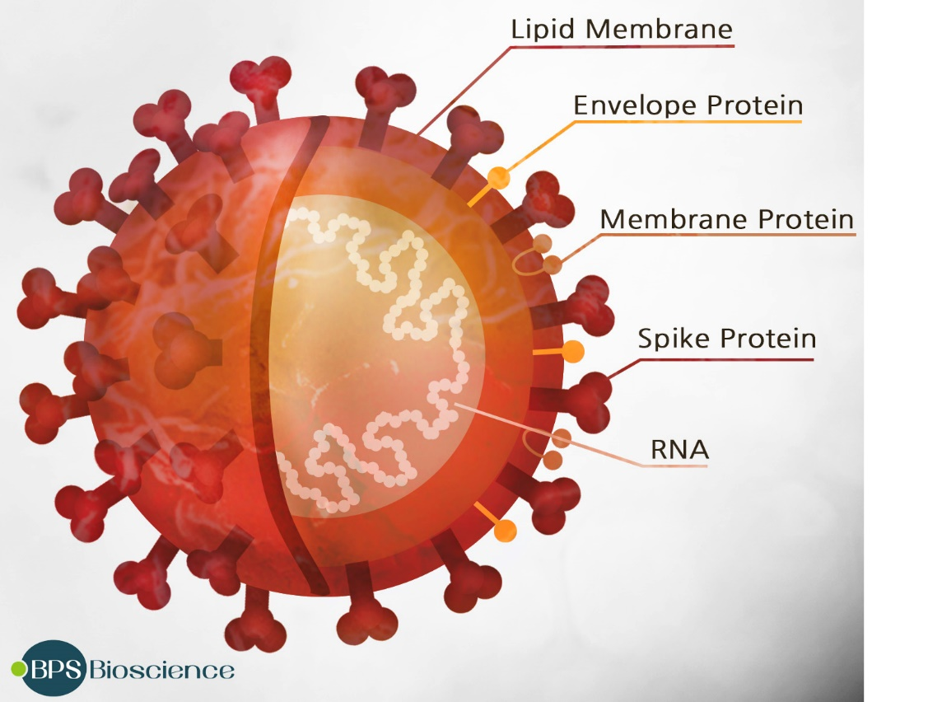

Slide 7
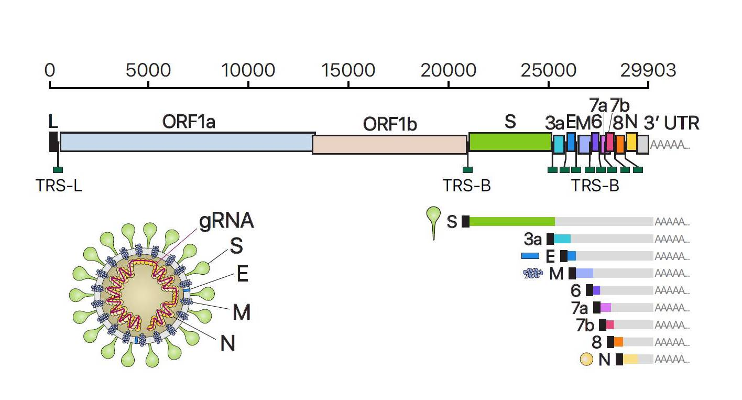

Slide 8
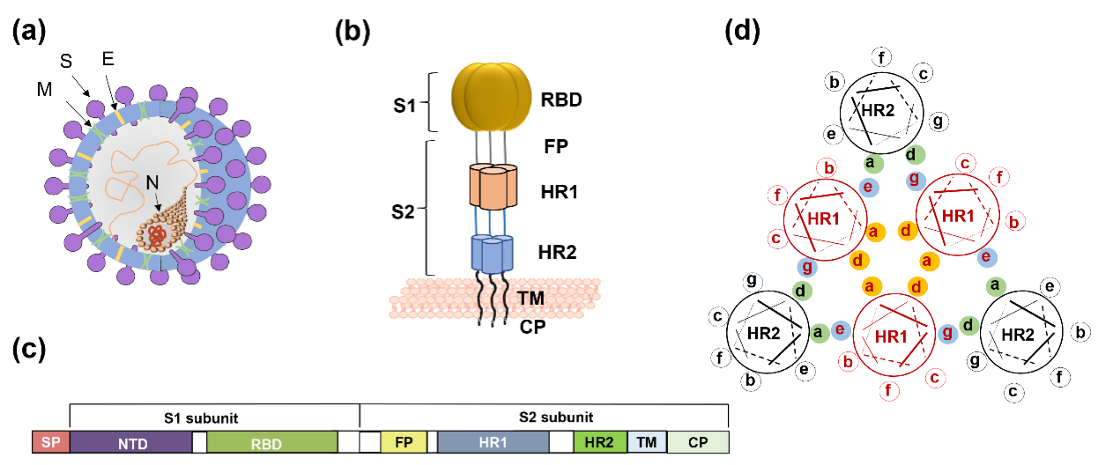

Slide 9
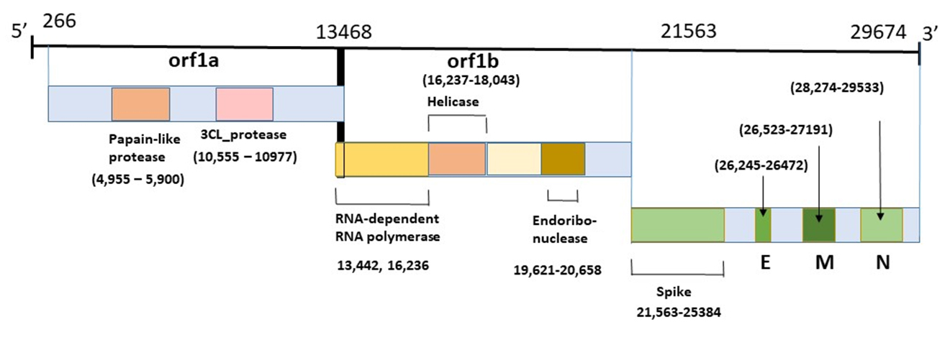

Slide 10
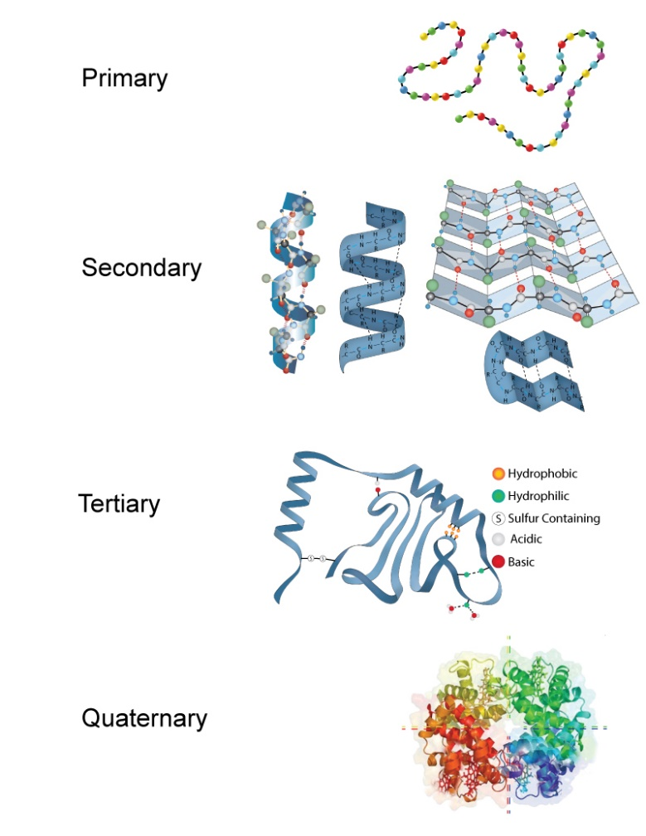
Solvent accessibility

Slide 11
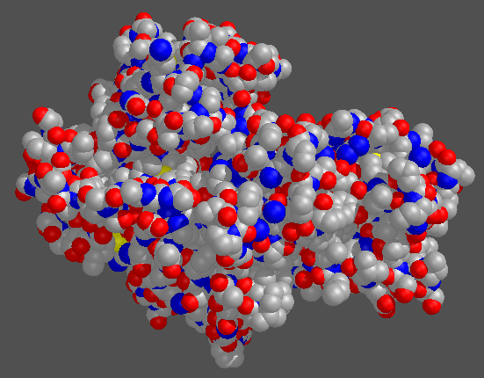

Slide 12
First week
NCBI- Finding the sequence
CLC sequence viewer- workbench
Exposed protein assessment
Signal peptide
Conserve regions

Slide 13
Exposed protein assessment (solvent accessibility)
http://raptorx.uchicago.edu/StructurePropertyPred/predict/
http://www.compbio.dundee.ac.uk/jpred4/cgi-bin/jpred_form
http://polyview.cchmc.org/
https://predictprotein.org

Slide 14
Signal peptide
http://www.cbs.dtu.dk/services/SignalP-4.1/
http://www.cbs.dtu.dk/services/SignalP/

Slide 15
Transmembrane
http://www.cbs.dtu.dk/services/TMHMM/
http://www.enzim.hu/hmmtop/html/submit.html
http://www.sacs.ucsf.edu/cgi-bin/memsat.py

